Slide 1
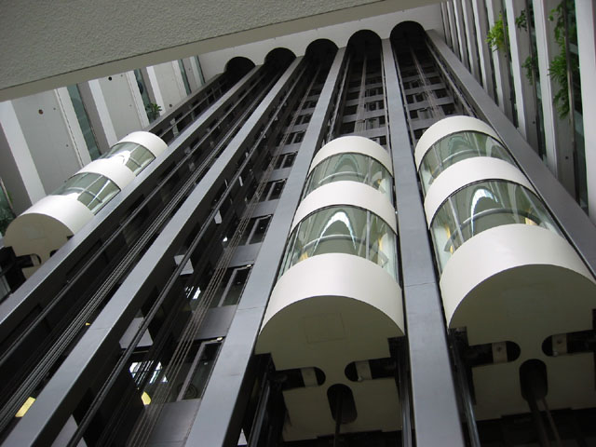
ELEVATORS AND ESCALATORS

Slide 2
The elevator (or lift in the Commonwealth excluding Canada) is a type of vertical transport equipment that efficiently moves people or goods between floors (levels,decks)of a building, vessel or other structure.
Elevators are generally powered by electric motors that either drive traction cables or counterweight systems like a hoist, or pump hydraulic fluid to raise a cylindrical piston like a jack.

Slide 3
ELEVATORS
An elevator is a type of vertical transport equipment.
Elevators are generally powered by electric motors that either drive traction cables or counterweight systems like a hoist, or pump hydraulic fluid to raise a cylindrical piston like a jack.
Because of wheelchair access laws, elevators are often a legal requirement in new multistory buildings, especially where wheelchair ramps would be impractical.
A modern day lift consists of a cab mounted on a platform within an enclosed space called a shaft or sometimes a “ hoistway “.
Hydraulic lifts use the principles of hydraulics to pressurize an above ground or in-ground piston to raise and lower the car.
Roped hydraulics use a combination of both ropes and hydraulic power to raise and lower cars.
Hydraulic lifts are cheaper, but installing cylinders greater than a certain length becomes impractical for very high lift hoistways. Hydraulic lifts are usually slower than traction lifts.

Slide 4
Design
An elevator is essentially a platform that is either pulled or pushed up by a mechanical means.
In the past, elevator drive mechanisms were powered by steam and water hydraulic pistons or by hand.
A modern day elevator consists of a cab (also called a "cage" or "car") mounted on a platform within an enclosed space called a shaft or sometimes a "hoistway".
Hydraulic elevators use the principles of hydraulics (in the sense of hydraulic power) to pressurize an above ground or in-ground piston to raise and lower the car.
Elevator doors protect riders from falling into the shaft.

Slide 5
The most common configuration for elevator door is to have two panels that meet in the middle, and slide open laterally.
In a cascading telescopic configuration for elevator door (potentially allowing wider entryways within limited space), the doors run on independent tracks so that while open, they are tucked behind one another, and while closed, they form cascading layers on one side.
Machine room-less elevators are designed so that most of the components fit within the shaft containing the elevator car; and a small cabinet houses the elevator controller.
the benefits of MRL are
-creates more usable space
-use less energy (70-80% less than hydraulic elevators)
-uses no oil
-can operate at faster speeds than hydraulics but not normal traction units.

Slide 6
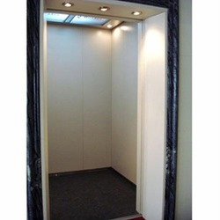
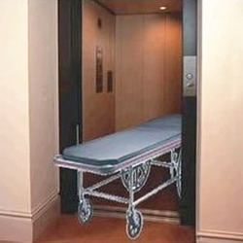
Types of elevators
Passenger elevator - Elevator are the main transportation arteries in the modern building and are vital in determining a building's economic success. All types of passenger lifts of different capacity and speed.Latest passenger lifts comprises of VVVF Close loop microprocessor Controller with sophisticated steel cage & latest electronic components for minimum and easy maintenance as well as low power consumption as per today's need.
Strecher elevator- Strecher elevator also cater to the health sector by providing specialized range of Stretcher Elevators suited for application in hospitals, health centers and other similar places. A Stretcher Elevator provides highly stable and smooth operation as it utilizes inverter control technology and lowest noise mechanism. With blurring logic and group control of these Elevators, the waiting time is also reduced. These highly spacious Elevators can easily accommodate stretchers and other medical equipment

Slide 7
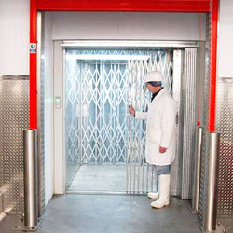
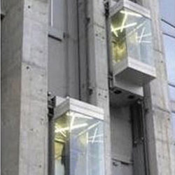
Good elevators - Goods Elevators are used in different industries for lifting heavy goods and items. These goods elevators are precision designed to have excellent lifting capacity & maintenance less working mechanism. Offered at industry leading prices, it make sure that the work orders for these goods lifts are executed with in the shortest time.
Panoramic elevators - panoramic elevators , panoramic lift are designed basically for malls and other commercials buildings. It has an overlook over other elevators. Visible on one side and to step aside on the floors of your will on the other side. Built in speed very high, comfort level exclusive and excitement of viewing the on-goings of the place your at is an addition to the developments of these machines. Traveling on Panoramic elevators , panoramic lift is a treat, the furniture and the view is not some that can be explained.

Slide 8
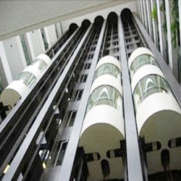
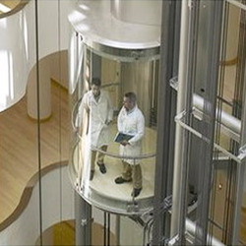
Capsule elevators - Capsule Elevators act as Architectural highlights on prestigious buildings. They can be called the ornaments of a building as they enhance its beauty and bring life into it. Its design, features and infinite options add its optimum travel comfort. It has aesthetically attractive interiors with large glass viewing panel. Capsule lifts demand specialized knowledge and had the experience at its best.
Glass elevators - Glass elevators from skylark combine speed, efficiency, simplicity and easy maintenance at competitive prices. these elevators are intended for use in residential apartments, hotels, banks and similar applications, where the ease of use by individuals is important. Is available with variable voltage, variable frequency drive systems as options enabling perfect leveling and energy efficiency.

Slide 9
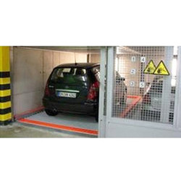
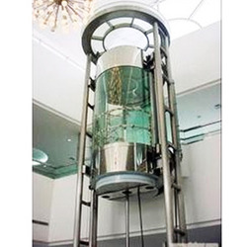
Automobile elevators - A car elevator is installed where ramps are considered space-in conservative. Car elevators are usually used in parking the vehicles at different floors, automobile show rooms, automobile service centers etc. The car elevator usually has got the entrance on opposite sides so that the car can enter from one end and leave from the opposite end.
Hydraulic elevators - Hydraulic drive systems have a motor-pump unit which supplies pressurized fluid via flexible hoses to a hydraulic cylinder. The cylinder provides the elevator car with motion indirectly. An electric motor drives the pump. Control of the system is by electro-hydraulic valves; ascent is driven under pressure and descent under gravity using the weight of the elevator car.

Slide 10
The following are suggested inside dimensions and rated capacities:
• Office buildings: 6 feet 8 inches wide by 5 feet 5 inches deep; 3,500 pounds.
• Apartment buildings: 6 feet 8 inches wide by 4 feet 3 inches deep; 2,500 pounds
• Hotels/motels: 6 feet 8 inches wide by 5 feet 5 inches deep; 3,500 pounds.
• Service elevators: 5 feet 4 inches wide by 8 feet 5 inches deep; 4,500 pounds.
• Hospital passenger elevators: 6 feet 8 inches wide by 5 feet 5 inches deep; 3,500 pounds.
• Hospital vehicle elevators: 5 feet 9 inches wide by 10 feet deep; 6,000 pounds.
.

Slide 11
Office buildings:
One elevator is required for every 45,000 net usable square feet.
The ratio of the number of floors to the number of elevators should be two to one or two and a half to one, depending on the occupancy of the building.
The more dense the population, the more elevators needed.
The number of elevators in a single group should not exceed eight and no single group should serve more than 16 levels.
In buildings of four to eight floors, a separate service elevator should be considered.
Over nine floors, a service elevator is virtually required.

Slide 12
Hotels/motels:
Provide one elevator for every 75 rooms with a minimum of one elevator up to three floors.
Do not exceed 150 feet from farthest room to elevator.
When room service is provided, allow for one separate service elevator for every two passenger elevators.
Special-functions, meeting rooms, or lobby areas above entry level can increase the number of elevators.
.

Slide 13
Apartment / Condominium/Dormitory
One elevator for every 90 units with a maximum distance of 150 feet from elevators to the most distant unit.
Urban locations or high-price units might require one elevator for every 60 units.
Make one elevator oversize (at least 3,500 pounds) to accommodate furniture.
In buildings 10 floors or more,consider a separate service elevator
1 pound=0.453592kg

Slide 14
Escalators

Slide 15
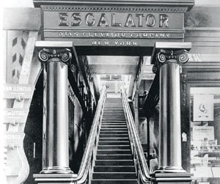
Escalator = Elevator + Scala (Steps)
Nathan Ames, of Saugus, Massachusetts, in the US, invented the first escalator in 1859.
He called his invention as a revolving stairs but in the patent he does not mentioned the type of material he would be using.
Jesse Reno patented the first endless conveyor or elevator in 1892.
He produced the first working escalator, which he called the inclined elevator.

Slide 16
This escalator was installed next to the Old Iron Pier on Coney Island, New York, in 1896.
The escalator was later redisgned by Charles Seeberger in 1897 who created the name ‘escalator’ from the word ‘scala’, which in latin means steps and the word ‘elevator’ which had been already invented.

Slide 17
Introduction
An escalator is a moving staircase – a conveyor transport device for carrying people between floors of a building.
The device consists of a motor-driven chain of individual, linked steps that move up or down on tracks, allowing the step treads to remain horizontal.
Escalators are used around the world to move pedestrian traffic in places where elevators would be impractical.
Principal areas of usage include department stores, shopping malls, airports, transit systems, convention centers, hotels, arenas, stadiums and public buildings.

Slide 18
ESCALATORS
The benefits of escalators are many.
They have the capacity to move large numbers of people, and they can be placed in the same physical space as one might install a staircase.
They can be used to guide people toward main exits or special exhibits, and they may be weatherproofed for outdoor use.

Slide 19
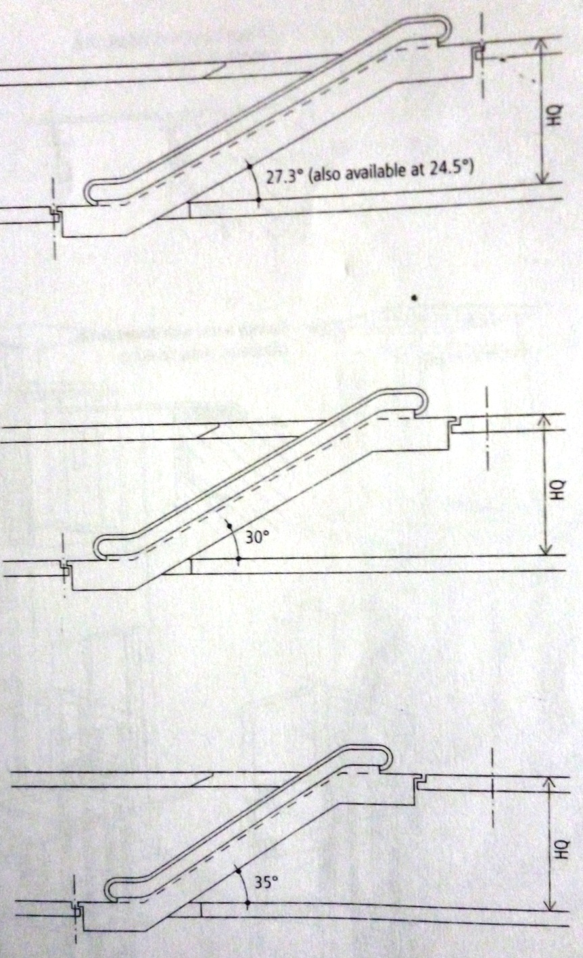
INCLINE AND TRANSPORTATION HEIGHT
Generally designed on an incline of 27.3, 30, 35 degrees.
35 degree escalator is most effective since it requires least amount of space.
This incline is applicable to a total transportation height of 6m
If the height is more than 6m than incline of 27.3 should be given

Slide 20
ESCALATOR CAPACITY
Most escalators are designed with 1000mm wide steps which allow passengers to move comfortably when carrying luggage and shopping bags.
600mm and 800mm wide steps are also available and generally used in low traffic areas
Standard transportation speed ranges between 0.5 to 0.65m/s
For a speed of 0.5m/s the theoretical capacity is:
600mm step width -4500 persons per hour
800mm step width -6750 persons per hour
1000mm step width -9000 persons/hour
Whenever possible its best to install two or more parallel sets of escalators.

Slide 21
TYPES
Escalators have three typical configuration options:
Parallel -up and down escalators "side by side or separated by a distance", seen often in metro stations and multilevel motion picture theaters
Crisscross -minimizes structural space requirements by "stacking" escalators that go in one direction, frequently used in department stores or shopping centers
Multiple parallel -two or more escalators together that travel in one direction next to one or two escalators in the same bank that travel in the other direction
Escalators are required to have moving handrails that keep pace with the movement of the steps.
The direction of movement (up or down) can be permanently the same, or be controlled by personnel according to the time of day, or automatically.

Slide 22
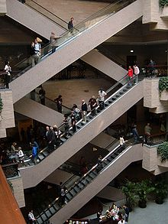
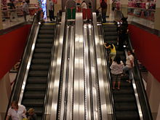
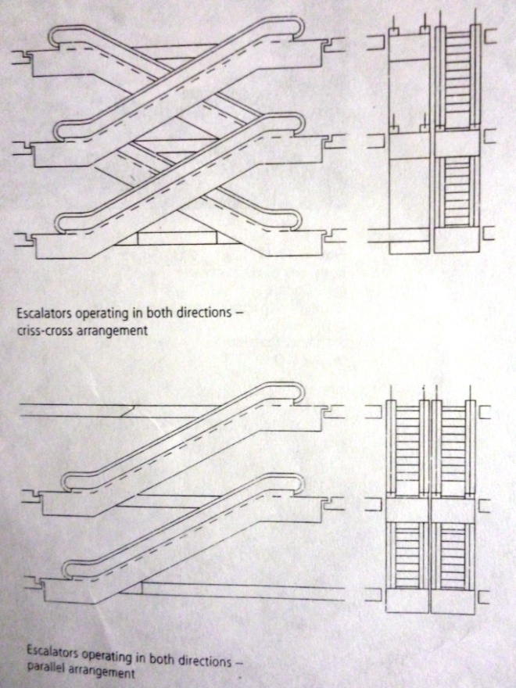
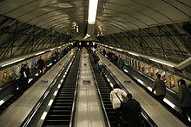

Slide 23
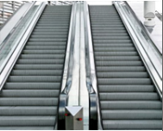
Types of escalators
Parallel: These type of escalator go up and down simultaneously.
1 Speed: 0.5m/s
2 Inclination: 30, 35
3 Step width: 800 / 1000
4 Power: 50 Hz / 3p
5 Handrails: Rubber /Stainless steel
6 Step: stainless steel
7 Landing plate: anti skid stainless steel.
8 Operation: Emergency stop button/ Key switch / Inspection operation.
9 Illumination: lighting under upper and lower landing steps.
10 Indicator: Failure indicator on control cabinet.

Slide 24
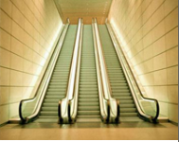
Multi parallel:
1 Speed: 0.5m/s
2 Inclinations: 30, 35
3 Step widths: 800 / 1000
4 Power: 50 Hz / 3p
5 Handrails: Rubber /Stainless steel
6 Step: stainless steel
7 Landing plate: anti skid stainless steel
8 Operation: Emergency stop button/ Key switch / Inspection operation.
9 Illumination: lighting under upper and lower landing steps.
10 Indicator: Failure indicator on control cabinet.

Slide 25
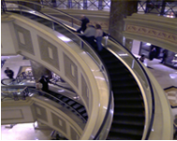
Spiral type escalators:
These are used to enhance the architectural beauty and to save the space.
1 Inclined Angle : 30"
2 Rated Speed [m/sec] : 25
3 Number of Persons : 6300 per hour
4 Rated Speed (mtrs./sec.) :25 m/ min.
5 Vertical Rise ( m ) : 3500 ~ 6600

Slide 26
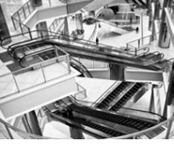
Criss-cross
They stacks the escalators that go in single direction and reduces structural space requirement.
1 Step width: 600 / 800 / 1000
2 Power: 300V / 50 Hz / 3p
3 Handrails: Rubber /Stainless steel.
4 Step: stainless steel.
5 Landing plate: anti skid stainless steel.
6 Operation: Emergency stop button / Key switch / Inspection operation.
7 Illumination: lighting under upper and lower landing steps.
8 Indicator: Failure indicator on control cabinet.

Slide 27
components
Landing platform: These two platforms house the curved sections of the tracks, as well as the gears and motors that drive the stairs. The top platform contains the motor assembly and the main drive gear, while the bottom holds the step return idler sprockets.
Floor plate: It provides a place for the passengers to stand before they step onto the moving stairs. This plate is flush with the finished floor and is either hinged or removable to allow easy access to the machinery below.

Slide 28
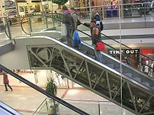
COMPONENTS

Slide 29
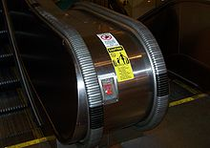
An escalator equipped with a "bellows" handrail.

Slide 30
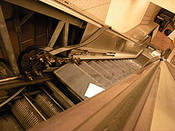
View of escalator steps on
continuous chain

Slide 31
Truss: The truss is a hollow metal structure that bridges the lower and upper landings. It is composed of two side sections joined together with cross braces across the bottom and just below the top. The ends of the truss are attached to the top and bottom landing platforms via steel or concrete supports. The truss carries all the straight track
Steps: The steps themselves are solid, one piece, die-cast aluminum or steel. The steps are linked by a continuous metal chain that forms a closed loop. The front and back edges of the steps are each connected to two wheels. The rear wheels are set further apart to fit into the back track and the front wheels have shorter axles to fit into the narrower front track. These are basically moving platform on which escalator passengers ride.

Slide 32
Handrail: The handrail provides a convenient handhold for passengers while they are riding the escalator. In an escalator, the handrail is pulled along its track by a chain that is connected to the main drive gear by a series of pulleys. It is constructed of four distinct sections. At the center of the handrail is a "slider", also known as a "glider ply", which is a layer of a cotton or synthetic textile
Deck board: These are used for preventing clothing from getting caught and other such problems
Balustrade: The side of an escalator extending above the Steps, which includes Skirt Guard, Interior Panel, Deck Board and Moving Handrails.

Slide 33
Tracks: The track system is built into the truss to guide the step chain, which continuously pulls the steps from the bottom platform and back to the top in an endless loop.
There are actually two tracks: one for the front wheels of the steps (called the step-wheel track) and one for the back wheels of the steps (called the trailer-wheel track).
The relative positions of these tracks cause the steps to form a staircase as they move out from under the comb plate.
This right angle bends the steps into a shape resembling a staircase

Slide 34
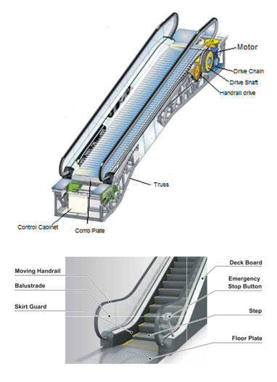

Slide 35
Advantages of Escalators
It helps a large no. of people in moving from one place to another at the same time and they reduce the need of elevator because people would not have to wait for elevator and escalator can carry a large no. of people at the same time.
It is helpful for the people that have pain in their legs and joints i.e it provide comfort to the people.
Escalators are effective when used as a mean of guidance and circulation.
Their speed can be adjusted which is helpful in managing the crowd.
When turned off they can be used a staircase

Slide 36
Disadvantages of Escalators
Waste of energy when not in use.
Possible injuries when stopped suddenly
Source of fear for small children

Slide 37
RAMPS
Ramps are sloping surface that can be used to provide an easy connection from floor to floor especially when large numbers of people or vehicles are moving from time to time.
Ramps are adopted for buildings, such as stadiums, railroad
stations, exhibition halls, garage buildings, etc.
it is generally built with slopes up to 15% (15 cm in 100 cm) but 10% is preferred.
With 10% slope and a storey height of 12 feet a ramp connecting two floors would have to be 120 feet long.
It can be curved, zigzagged, u-shaped or spiraled and in all cases should be constructed with a non-slip surface.

Slide 38
Design Consideration
An exterior location is preferred for ramps.
Indoor ramps are not recommended because they take up a great deal of space.
Ideally, the entrance to a ramp should be immediately adjacent to the stairs.

Slide 39
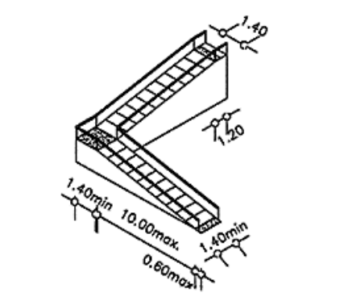
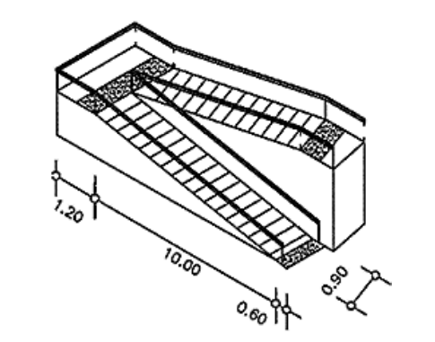

Slide 40
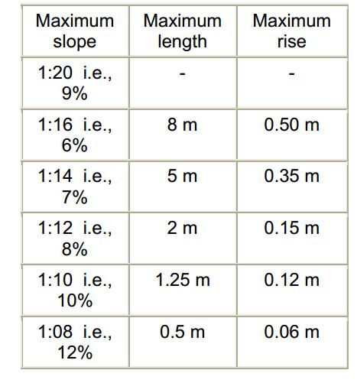
Width-The minimum width should be 0.90 m. Slope:

Slide 41
Design considerations
Landings
Ramps should be provided with landings for resting, maneuvering and avoiding excessive speed.
Landings should be provided for every 10.00 m, at every change of direction and at the top and bottom of every ramp.
Handrail
A protective handrail at least 0.40 m

Slide 42
Surface
The ramp surface should be hard and non-slip.
Tactile marking
A colored textural indication at the top and bottom of the ramp should be placed to alert sightless people as to the location of the ramp.
The marking strip width should not be less than 0.60 m.

Slide 43
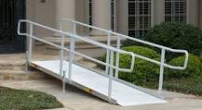

Slide 44
